Slide 1
Food Demand Prediction
-Using Machine Learning

Slide 2
Group Number - 27
Team Members
Sai Shashank Reddy Rachumalla(11547572)(Team Leader)
Amulya Akinapuram (11558530)
Nithin Chandra Vemula(11549346)

Slide 3
Intro
Abstract, Problem Statement

Slide 4
Abstract/Problem Statement
A demand prediction process is used in the retail and food industries to estimate the amount of products that a customer will purchase. This process is carried out by analyzing historical data and making predictions. In restaurants, it is very important that the supply of certain ingredients is not affected by the season and other hidden factors. This paper presents a case study that uses machine learning to predict the stock of various products. Also presents a demand forecasting algorithm that is capable of overcoming the wastage of short-life items. Used Regression algorithms can improve the performance of the forecasting process.

Slide 5
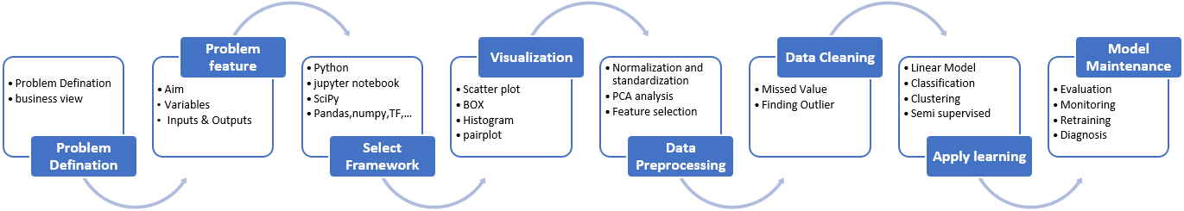
Workflow

Slide 6
Design
Dataset Description, Flow chat of Design, Implementation of data processing technique

Slide 7
Dataset Description
The dataset has the following data which can be used to predict the food demand using the following data.
We used 3 CSV files i.e., food_demand.csv, meal_info.csv and fulfilment_center_info.
The data has 9 columns and 2000 rows. Our target variable is number of orders.
Our variables Food id, Week, Center id, Meal id, Price at checkout, Base price, Number of orders, Category, Cuisine, City Code, and Region Code.

Slide 8
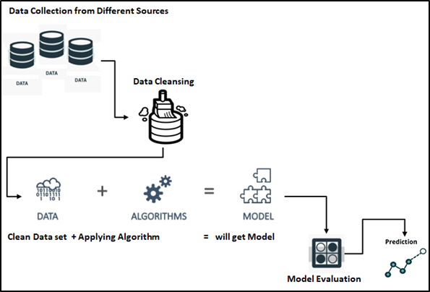
Flow chat of Design

Slide 9
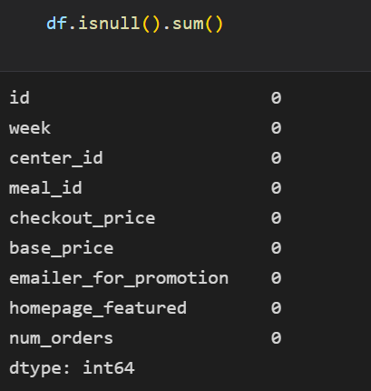
Data Processing Technique
Checked the missing values.

Slide 10
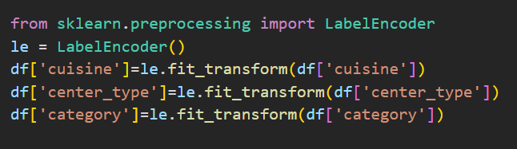
Encoding the categories of variables using LabelEncoder

Slide 11
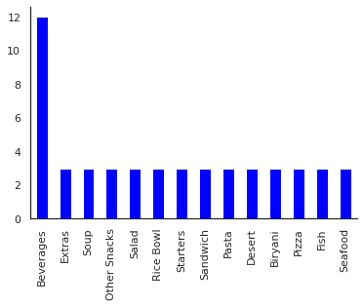
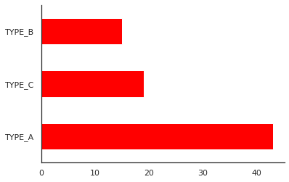
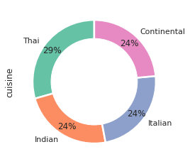
Data visualizations for categorical variables.
Cusine type in meal
Category type in meal
Center type in area

Slide 12
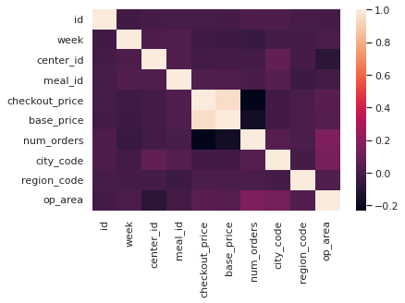
Correlation

Slide 13
Modelling
ML Models, its justification

Slide 14
Modelling
Models
XGBoost
Regression
Support
vector
Regression
Linear
Regression
Random Forest Regression
Linear Regression
Gradient Boosting Regression
Support Vector Regression
Random Forest Regression

Slide 15
Evaluation
Evaluation metrics, Accuracy

Slide 16
Evaluation
Models | MSE | MAE | RMSE | R-Squared
Linear Regression | 163393.50 | 195.19 | 404.22 | 0.14
Gradient Boosting Regression | 129247.91 | 156.06 | 359.51 | 0.32
Support vector Regression | 201456.23 | 193.96 | 448.83 | -0.06
Random Forest Regression | 15658.44 | 50.15 | 125.13 | 0.92

Slide 17
Result
We analyzed the dataset, merge the 3 datasets to get required results. Performed data visualizations. Trained the data to build 4 different models. To compare the model we used performance metrics such as Mean Squared Error, Root Mean Squared Error, Mean Absolute Error and R-Squared Score. By observing this metrics we conclude that Random Forest Regression is best model. And also performed hyperparameter tuning using GridSearchCV got an average error is 131.87 and improvement of 45%.

Slide 18
References
Dataset - https://www.kaggle.com/code/swetarajsinha/food-demand-forecasting/data
Code For Reference - https://www.kaggle.com/code/swetarajsinha/food-demand-forecasting/notebook
Dataset: https://www.kaggle.com/datasets/gauravsahani/food-demand-prediction-dataset
Aishwarya,K et al. (2020).Food Demand. Internaltion Research Journal of Engineering and Technology. https://tinyurl.com/23hdxatw

